Slide 1
Chapter 8 - Characters and Strings
Outline
8.1 Introduction
8.2 Fundamentals of Strings and Characters
8.3 Character Handling Library
8.4 String Conversion Functions
8.5 Standard Input/Output Library Functions
8.6 String Manipulation Functions of the String Handling Library
8.7 Comparison Functions of the String Handling Library
8.8 Search Functions of the String Handling Library
8.9 Memory Functions of the String Handling Library
8.10 Other Functions of the String Handling Library

Slide 2
Objectives
In this chapter, you will learn:
  To be able to use the functions of the character handling library (ctype).
  To be able to use the string and character input/output functions of the standard input/output library (stdio).
  To be able to use the string conversion functions of the general utilities library (stdlib).
  To be able to use the string processing functions of the string handling library (string).
  To appreciate the power of function libraries as a means of achieving software reusability.

Slide 3
8.1 Introduction
Introduce some standard library functions
  Easy string and character processing
  Programs can process characters, strings, lines of text, and blocks of memory
These techniques used to make
  Word processors
  Page layout software
  Typesetting programs

Slide 4
8.2 Fundamentals of Strings and Characters
Characters
  Building blocks of programs
    Every program is a sequence of meaningfully grouped characters
  Character constant
    An int value represented as a character in single quotes
    'z' represents the integer value of z
Strings
  Series of characters treated as a single unit
    Can include letters, digits and special characters (*, /, $)
  String literal (string constant) - written in double quotes
    "Hello"
  Strings are arrays of characters
    String a pointer to first character
    Value of string is the address of first character

Slide 5
8.2 Fundamentals of Strings and Characters
String definitions
  Define as a character array or a variable of type char *
      char color[] = "blue";
      char *colorPtr = "blue";
  Remember that strings represented as character arrays end with '\0'
    color has 5 elements
Inputting strings
  Use scanf
      scanf("%s", word);
    Copies input into word[]
    Do not need & (because a string is a pointer)
  Remember to leave room in the array for '\0'

Slide 6
8.3 Character Handling Library
Character handling library
  Includes functions to perform useful tests and manipulations of character data
  Each function receives a character (an int) or EOF as an argument
The following slide contains a table of all the functions in <ctype.h>

Slide 7
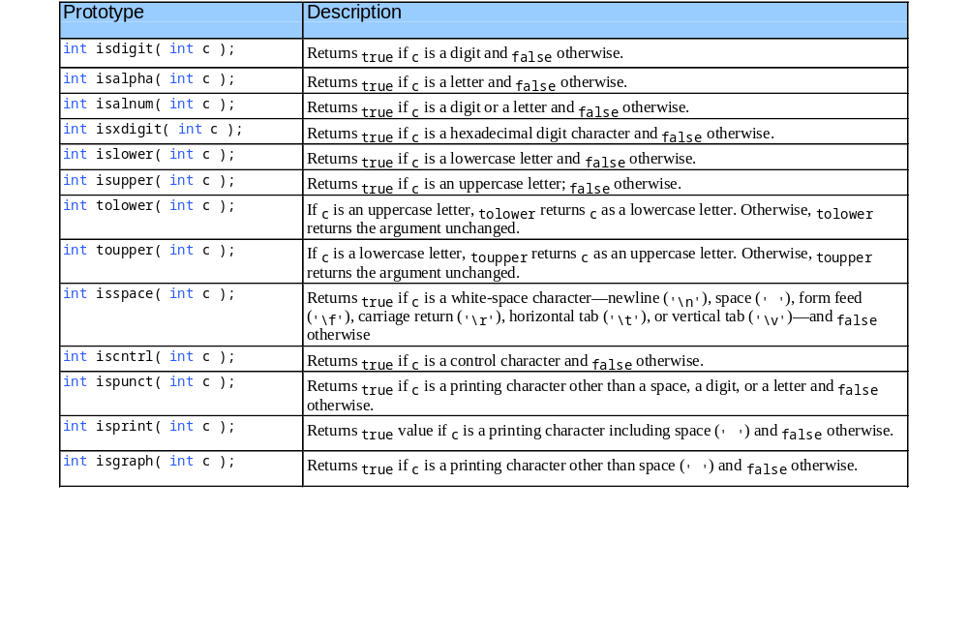
8.3 Character Handling Library

Slide 8
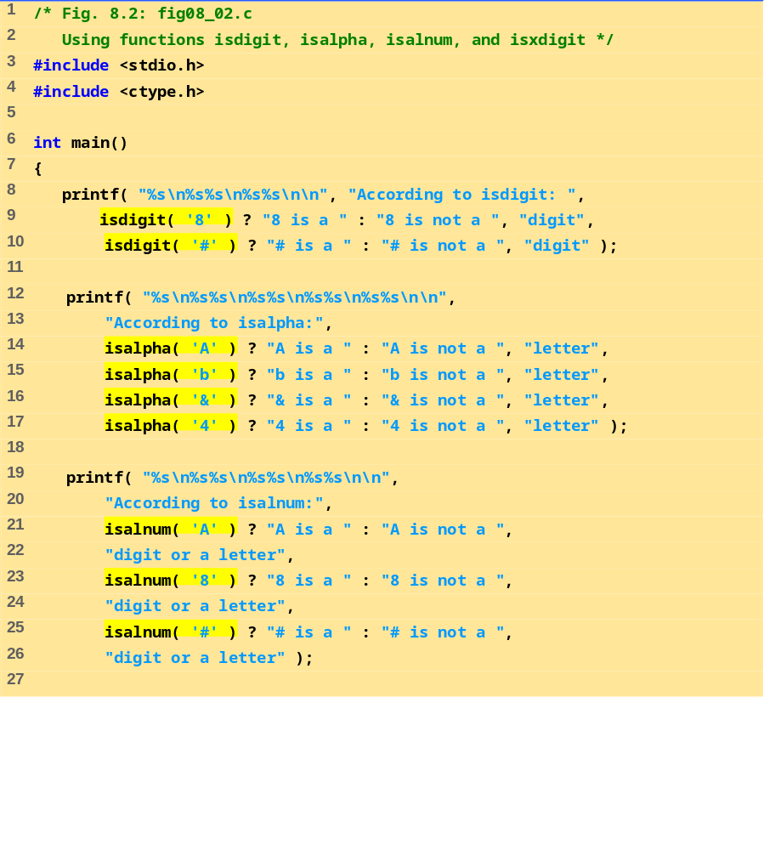
fig08_02.c (Part 1 of 2)

Slide 9
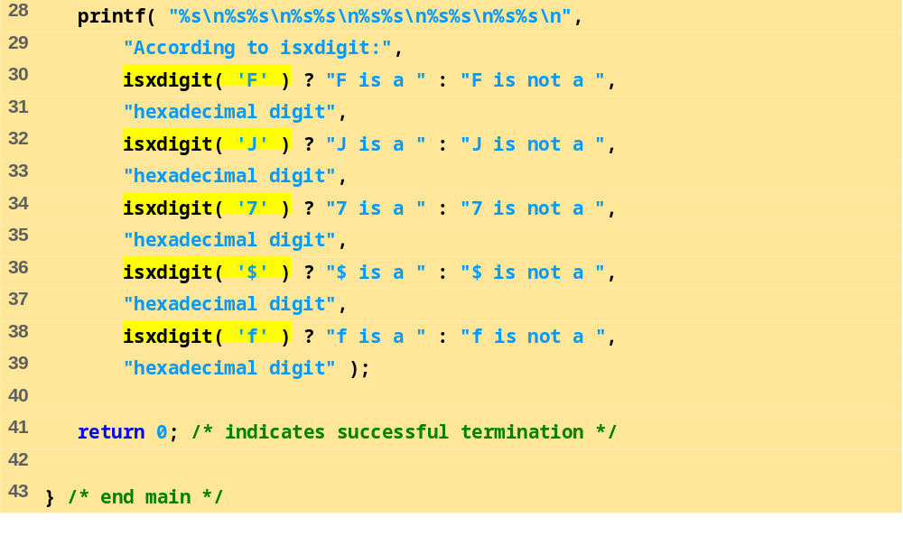
fig08_02.c (Part 2 of 2)

Slide 10
According to isdigit:
8 is a digit
# is not a digit
According to isalpha:
A is a letter
b is a letter
& is not a letter
4 is not a letter
According to isalnum:
A is a digit or a letter
8 is a digit or a letter
# is not a digit or a letter
According to isxdigit:
F is a hexadecimal digit
J is not a hexadecimal digit
7 is a hexadecimal digit
$ is not a hexadecimal digit
f is a hexadecimal digit
Program Output

Slide 11
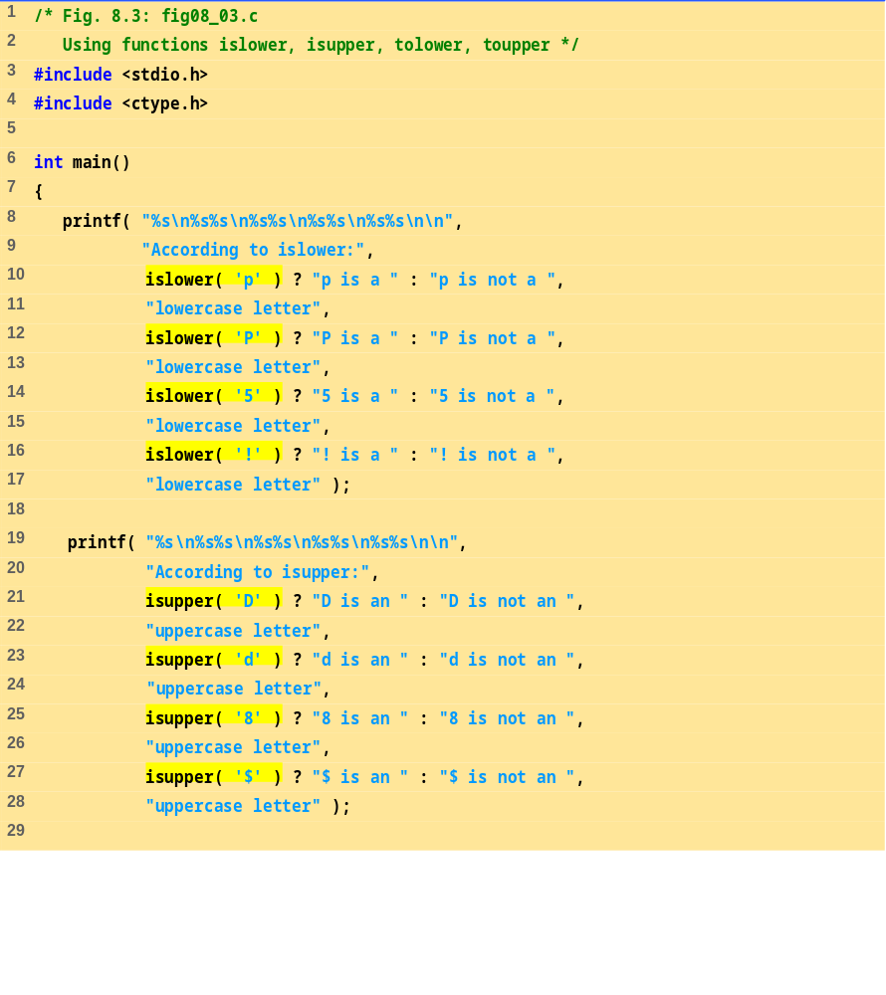
fig08_03.c (Part 1 of 2)

Slide 12
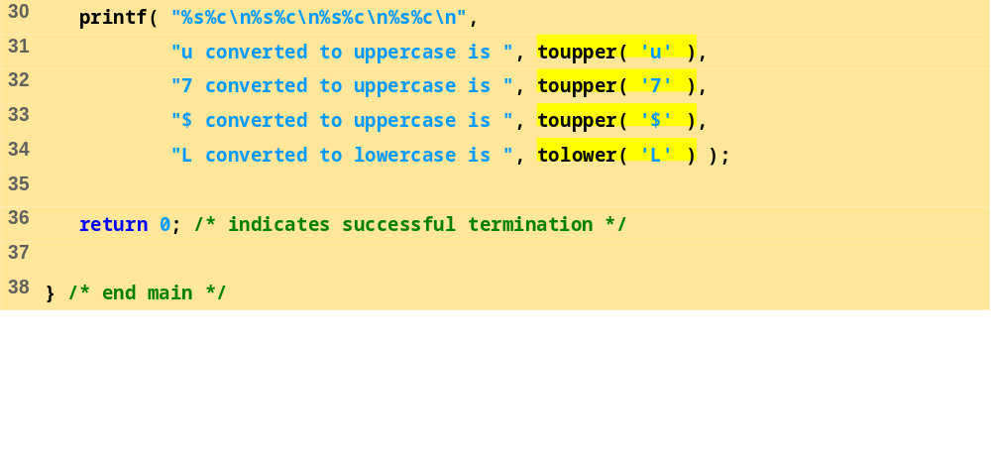
fig08_03.c (Part 2 of 2)
Program Output
According to islower:
p is a lowercase letter
P is not a lowercase letter
5 is not a lowercase letter
! is not a lowercase letter
According to isupper:
D is an uppercase letter
d is not an uppercase letter
8 is not an uppercase letter
$ is not an uppercase letter
u converted to uppercase is U
7 converted to uppercase is 7
$ converted to uppercase is $
L converted to lowercase is l

Slide 13
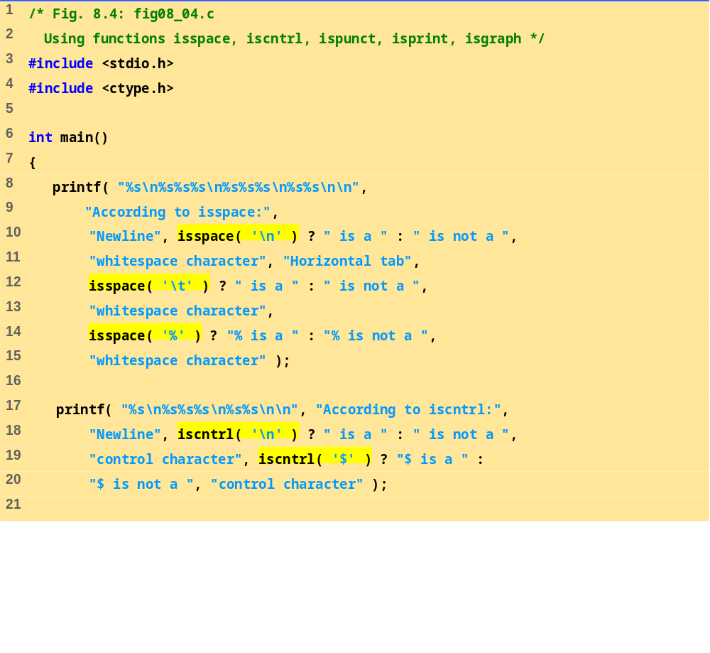
fig08_04.c (Part 1 of 2)

Slide 14
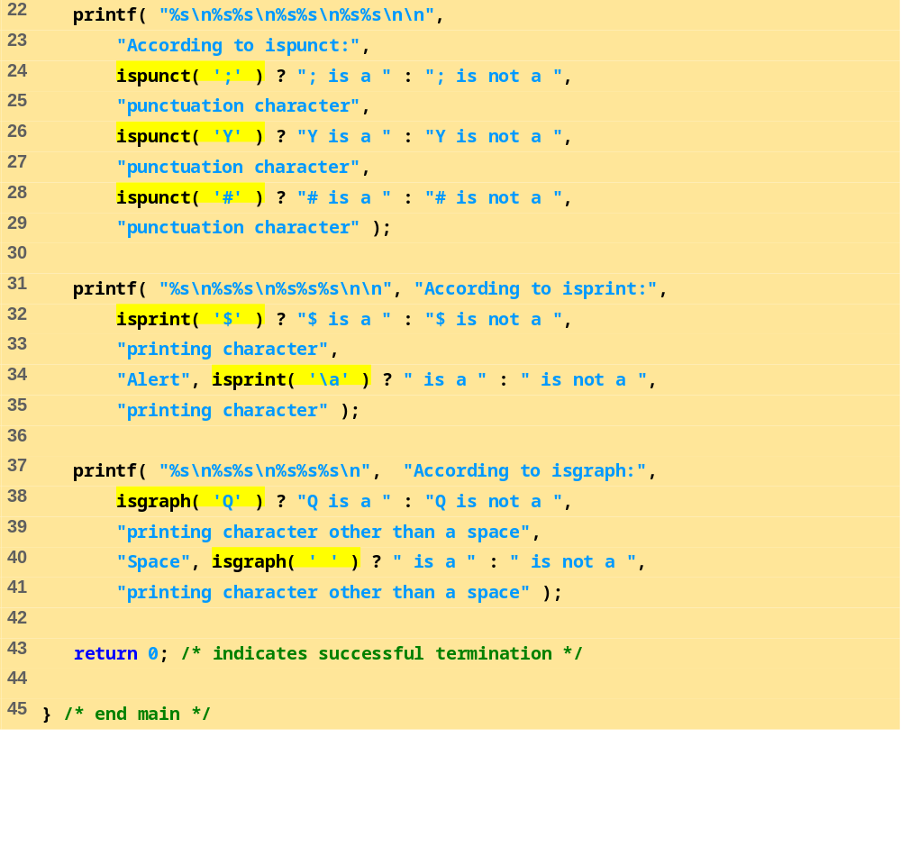
fig08_04.c (Part 2 of 2)

Slide 15
According to isspace:
Newline is a whitespace character
Horizontal tab is a whitespace character
% is not a whitespace character
According to iscntrl:
Newline is a control character
$ is not a control character
According to ispunct:
; is a punctuation character
Y is not a punctuation character
# is a punctuation character
According to isprint:
$ is a printing character
Alert is not a printing character
According to isgraph:
Q is a printing character other than a space
Space is not a printing character other than a space
Program Output

Slide 16
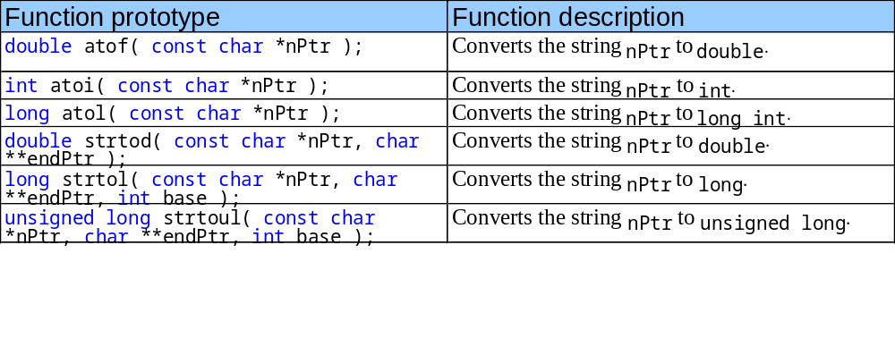
8.4 String Conversion Functions
Conversion functions
  In <stdlib.h> (general utilities library)
Convert strings of digits to integer and floating-point values

Slide 17
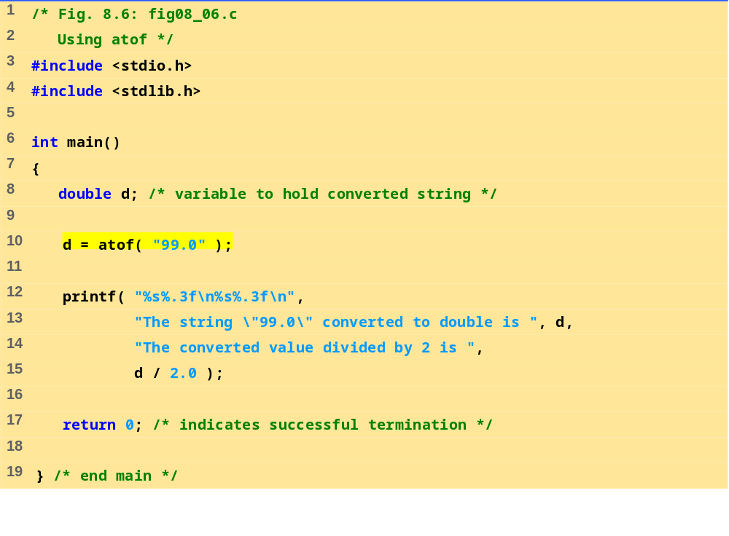
fig 08_06.c
Program Output
The string "99.0" converted to double is 99.000
The converted value divided by 2 is 49.500

Slide 18
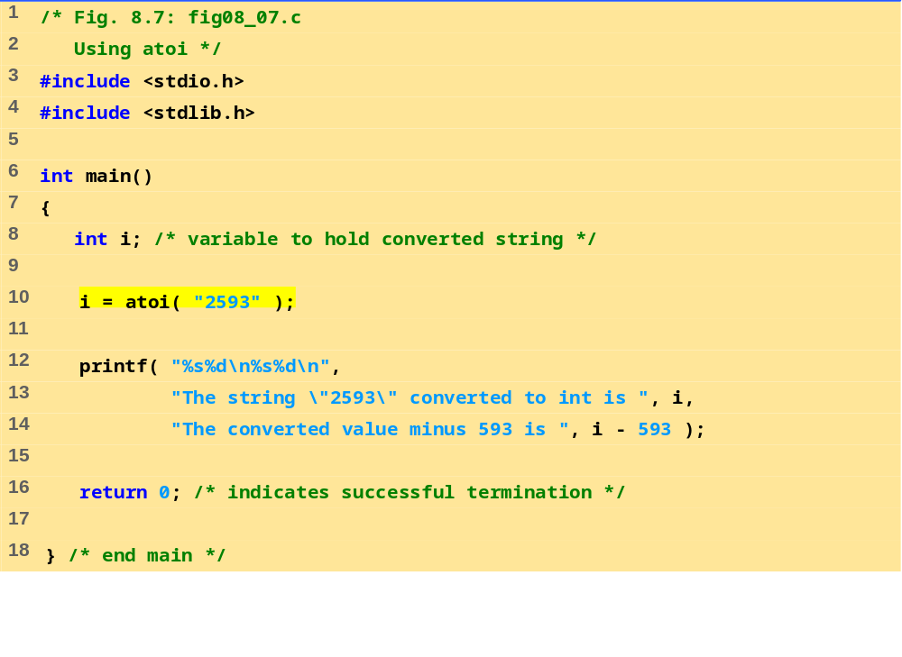
fig08_07.c
Program Output
The string "2593" converted to int is 2593
The converted value minus 593 is 2000

Slide 19
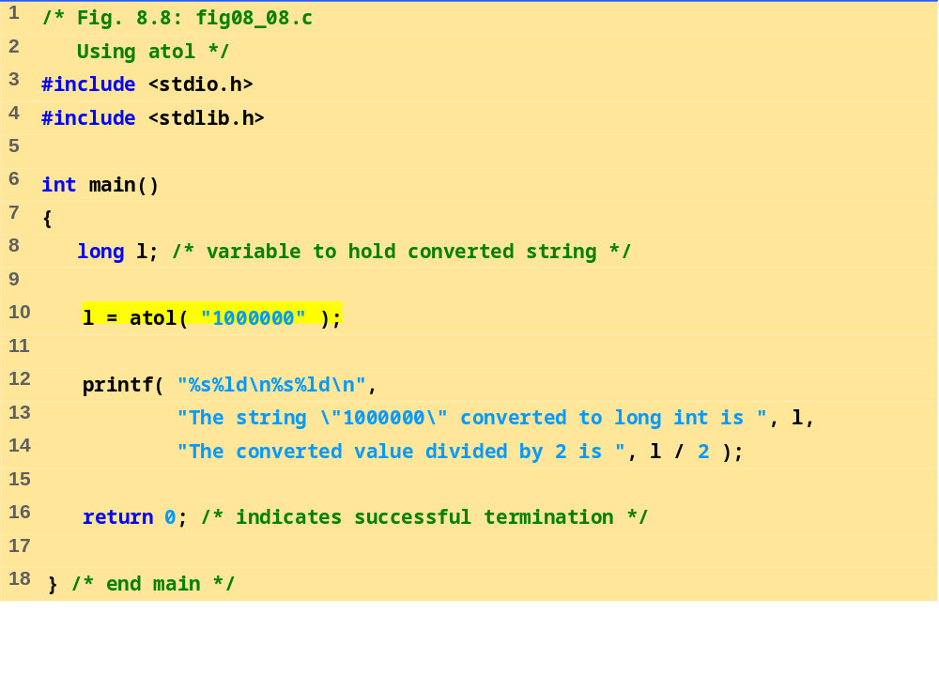
fig08_08.c
Program Output
The string "1000000" converted to long int is 1000000
The converted value divided by 2 is 500000

Slide 20
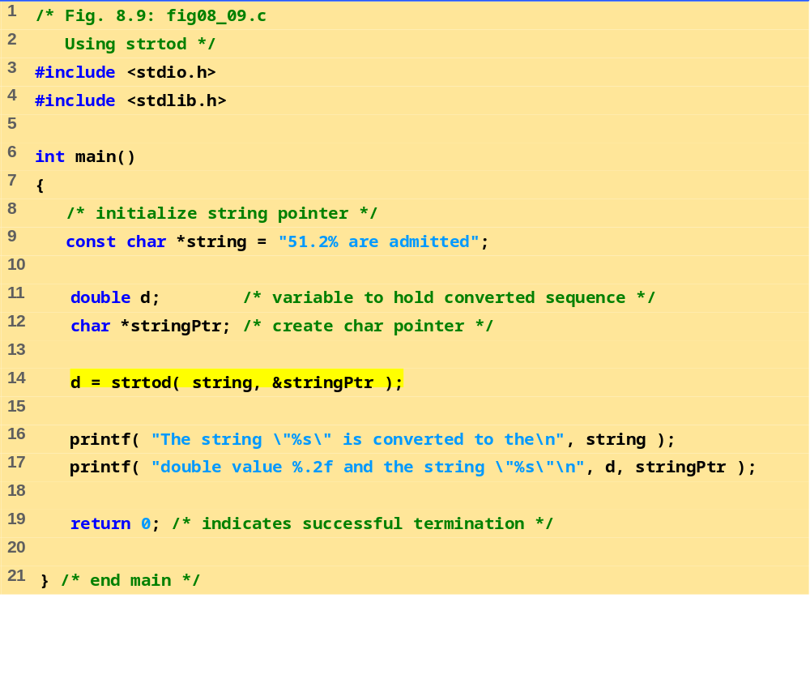
fig08_09.c
Program Output
The string "51.2% are admitted" is converted to the
double value 51.20 and the string "% are admitted"

Slide 21
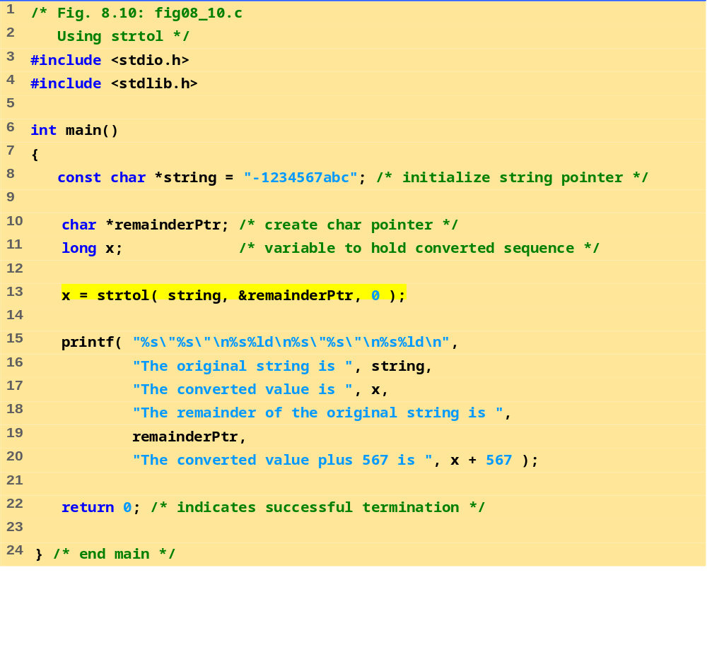
fig08_10.c
Program Output
The original string is "-1234567abc"
The converted value is -1234567
The remainder of the original string is "abc"
The converted value plus 567 is -1234000

Slide 22
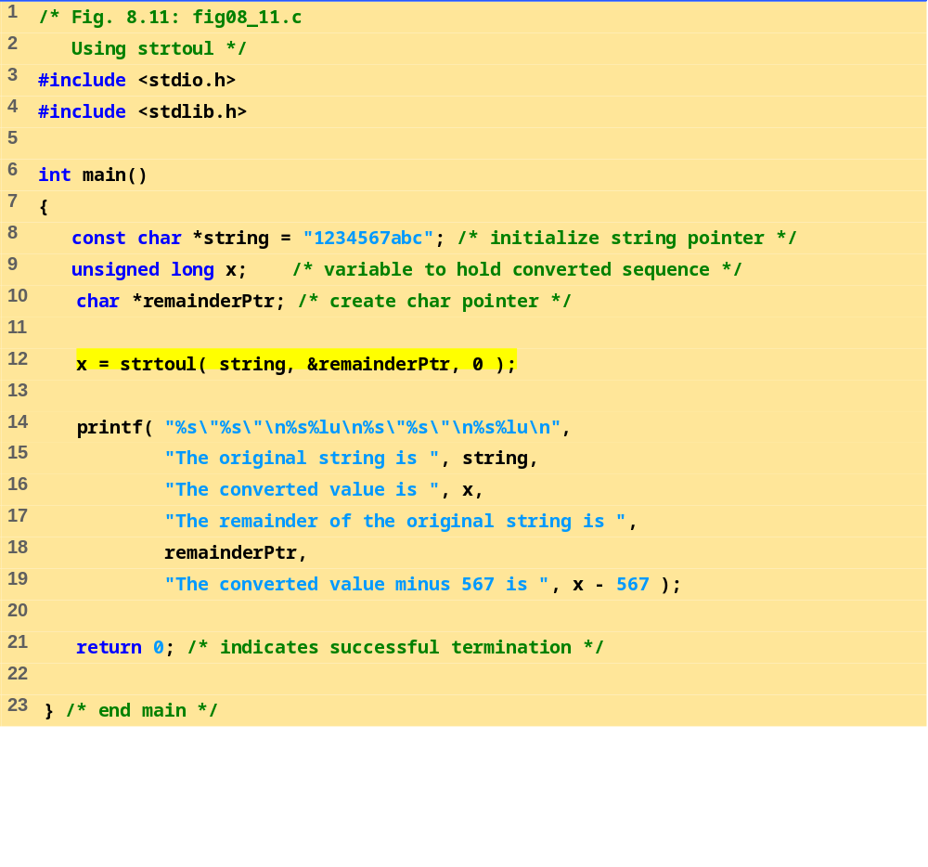
fig08_11.c
Program Output
The original string is "1234567abc"
The converted value is 1234567
The remainder of the original string is "abc"
The converted value minus 567 is 1234000

Slide 23
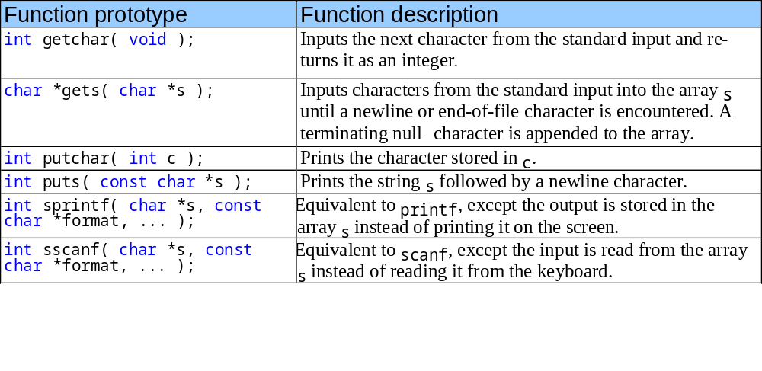
8.5 Standard Input/Output Library Functions
Functions in <stdio.h>
Used to manipulate character and string data

Slide 24
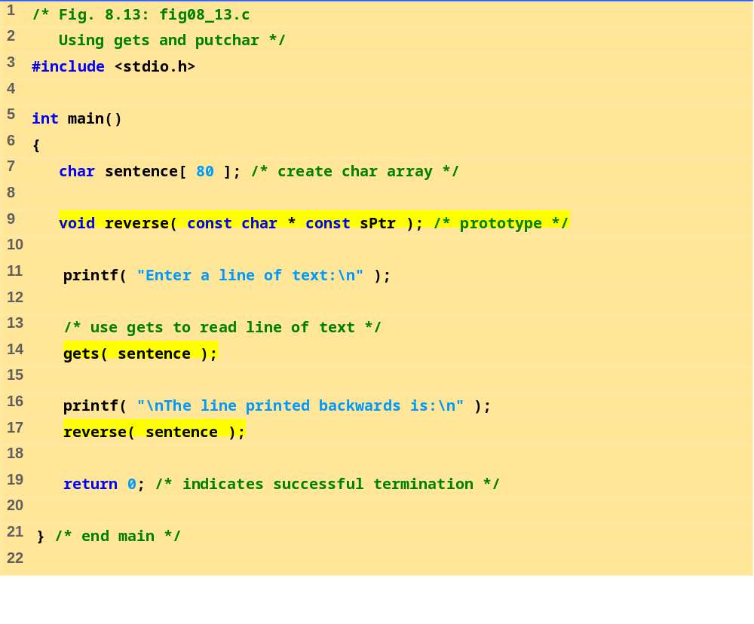
fig08_13.c (Part 1 of 2)

Slide 25
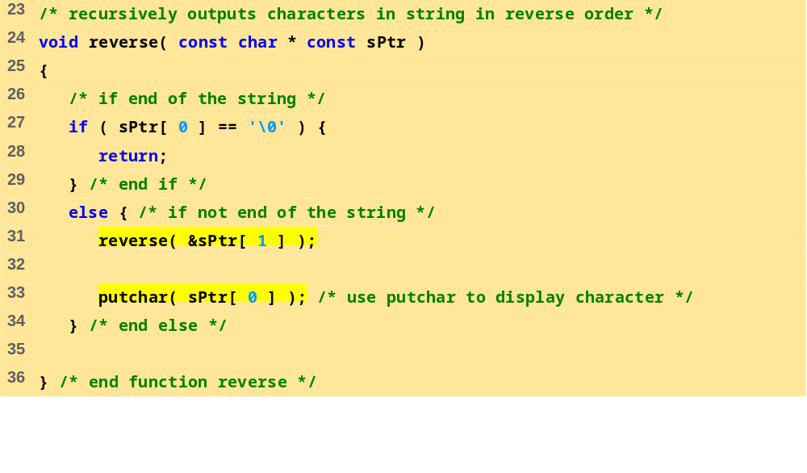
fig08_13.c (Part 1 of 2)
Program Output
Enter a line of text:
Characters and Strings
The line printed backwards is:
sgnirtS dna sretcarahC
Enter a line of text:
able was I ere I saw elba
The line printed backwards is:
able was I ere I saw elba

Slide 26
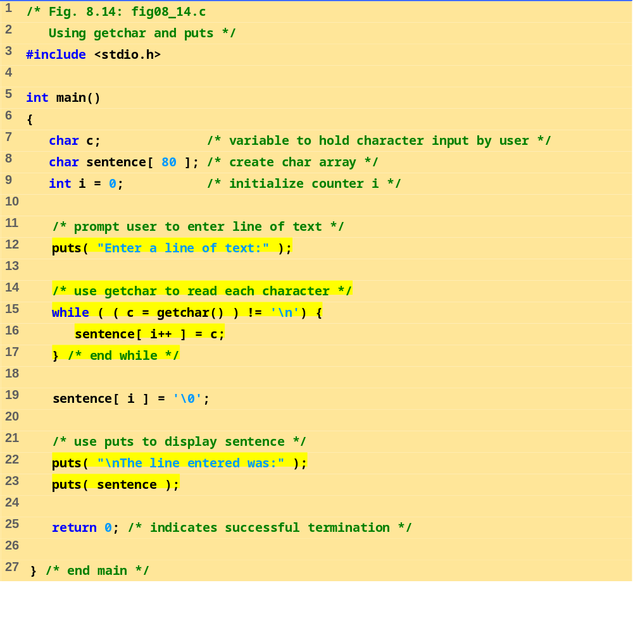
fig8_14.c

Slide 27
Enter a line of text:
This is a test.
The line entered was:
This is a test.
Program Output

Slide 28
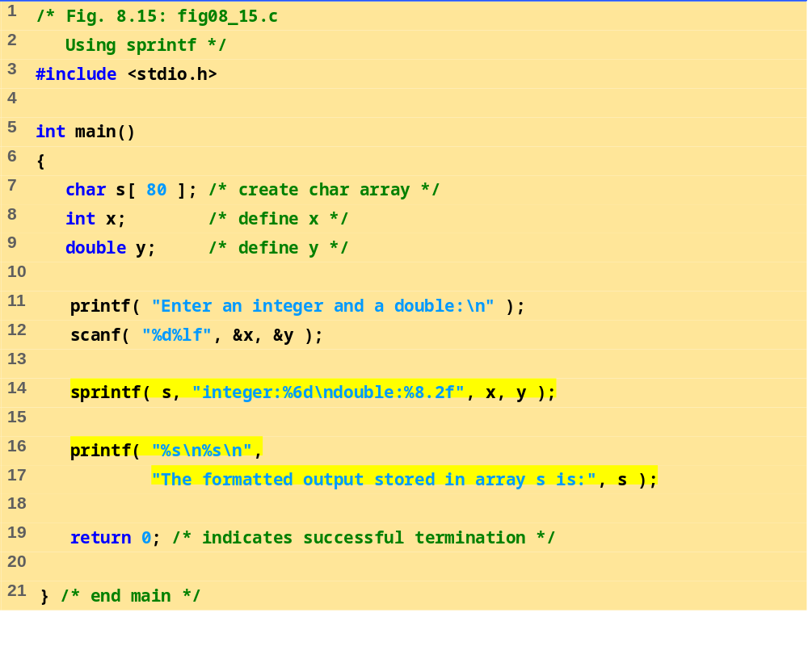
fig08_15.c
Program Output
Enter an integer and a double:
298 87.375
The formatted output stored in array s is:
integer: 298
double: 87.38

Slide 29
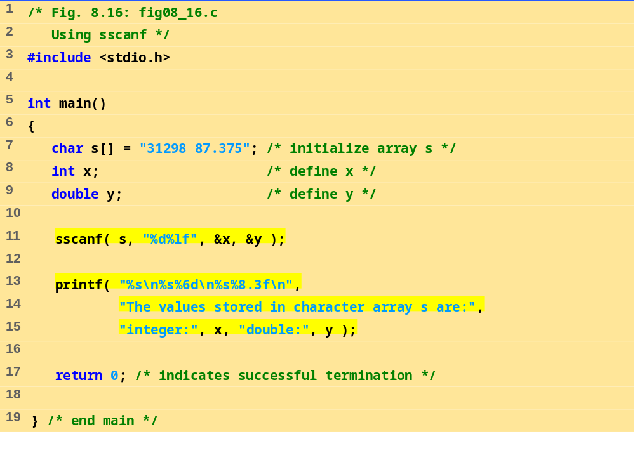
fig08_16.c
Program Output
The values stored in character array s are:
integer: 31298
double: 87.375

Slide 30
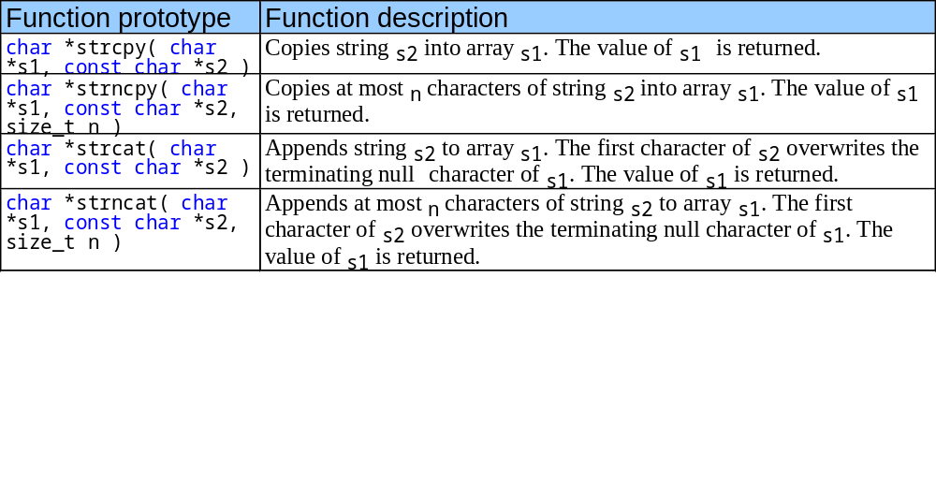
8.6 String Manipulation Functions of the String Handling Library
String handling library has functions to
  Manipulate string data
  Search strings
  Tokenize strings
  Determine string length

Slide 31
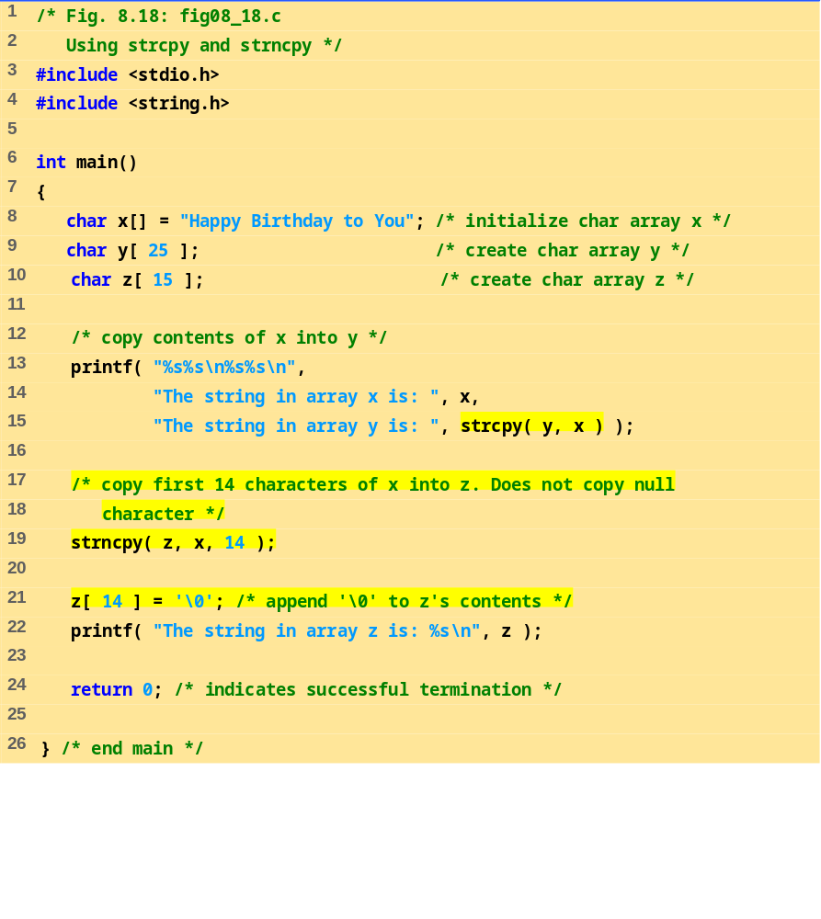
fig08_18.c
Program Output
The string in array x is: Happy Birthday to You
The string in array y is: Happy Birthday to You
The string in array z is: Happy Birthday

Slide 32
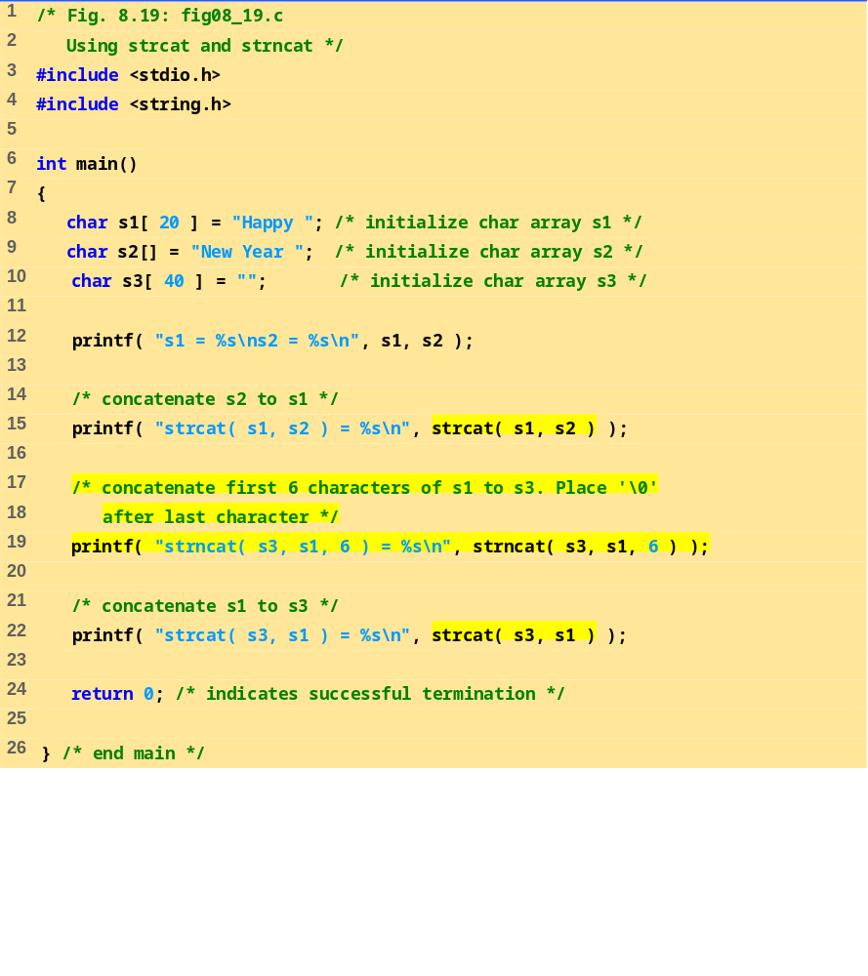
fig08_19.c

Slide 33
s1 = Happy
s2 = New Year
strcat( s1, s2 ) = Happy New Year
strncat( s3, s1, 6 ) = Happy
strcat( s3, s1 ) = Happy Happy New Year
Program Output

Slide 34
8.7 Comparison Functions of the String Handling Library
Comparing strings
  Computer compares numeric ASCII codes of characters in string
  Appendix D has a list of character codes
int strcmp( const char *s1, const char *s2 );
  Compares string s1 to s2
  Returns a negative number if s1 < s2, zero if s1 == s2 or a positive number if s1 > s2
int strncmp( const char *s1, const char *s2, size_t n );
  Compares up to n characters of string s1 to s2
  Returns values as above

Slide 35
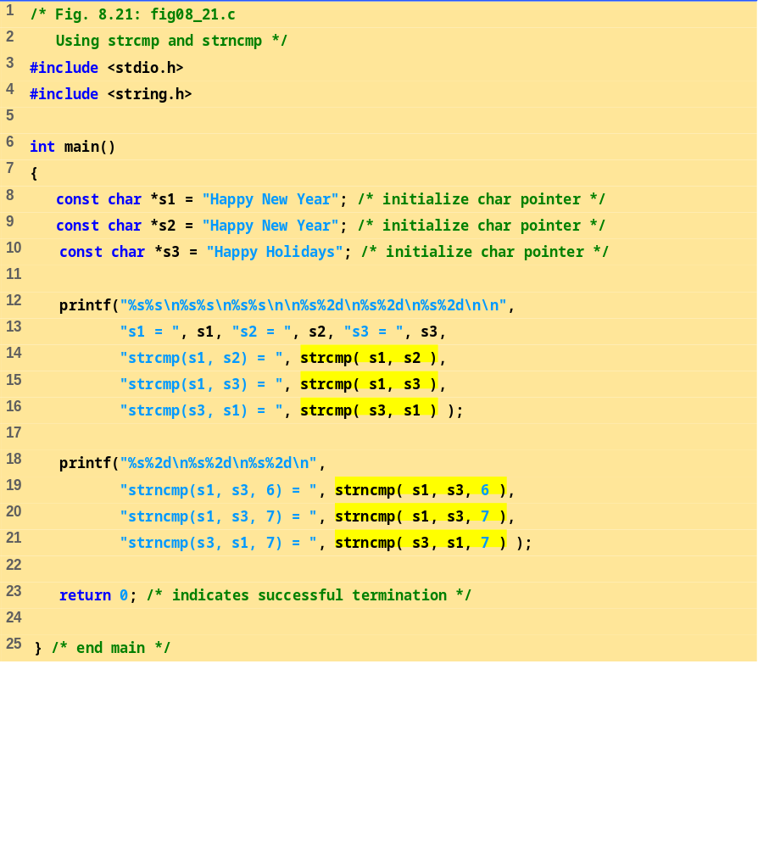
fig08_21.c

Slide 36
s1 = Happy New Year
s2 = Happy New Year
s3 = Happy Holidays
strcmp(s1, s2) = 0
strcmp(s1, s3) = 1
strcmp(s3, s1) = -1
strncmp(s1, s3, 6) = 0
strncmp(s1, s3, 7) = 1
strncmp(s3, s1, 7) = -1
Program Output

Slide 37
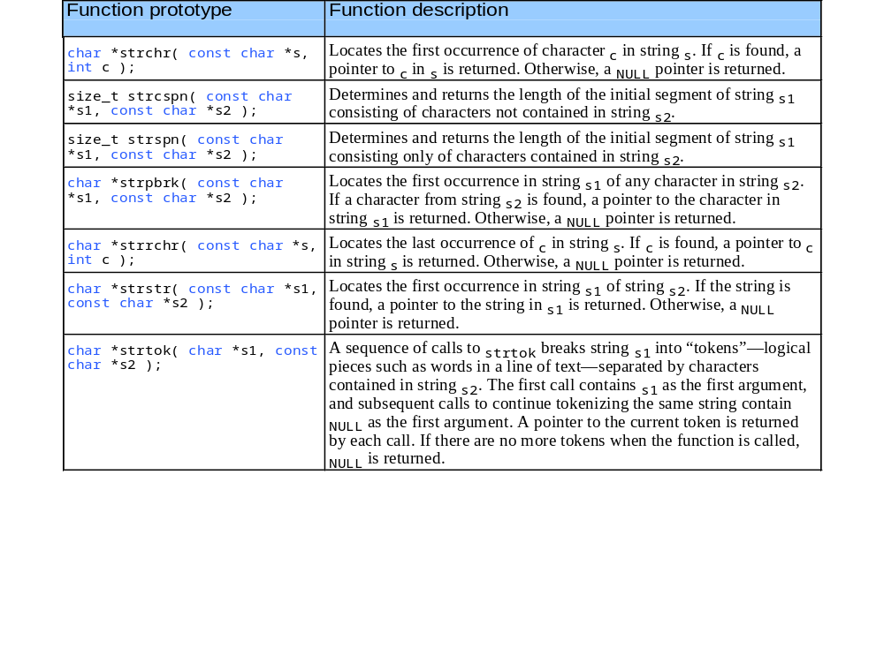
8.8 Search Functions of the String Handling Library

Slide 38
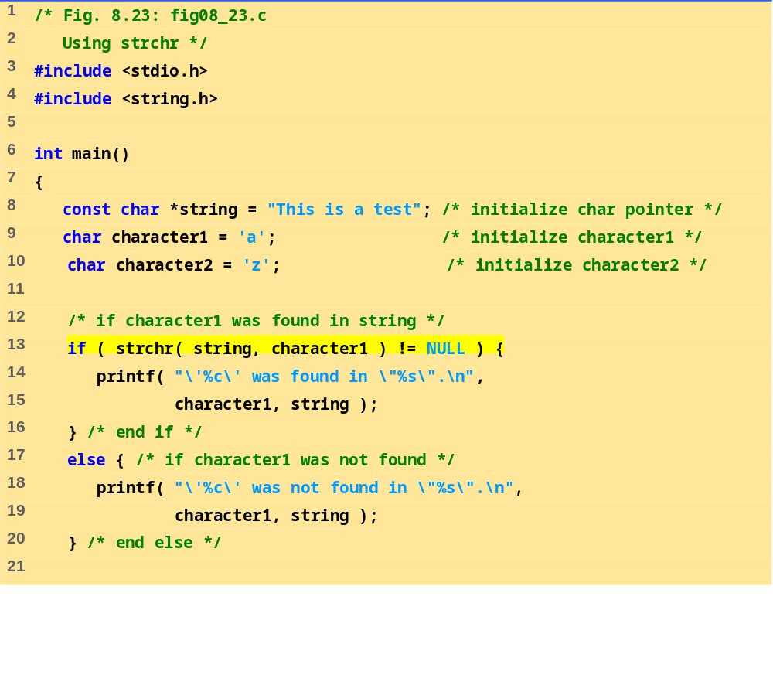
fig08_23.c (Part 1 of 2)

Slide 39
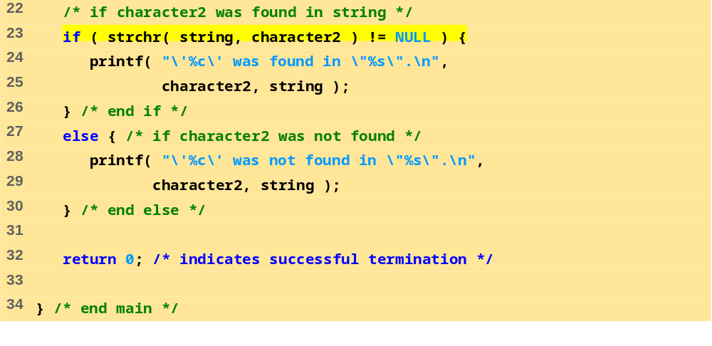
fig08_23.c (Part 2 of 2)
Program Output
'a' was found in "This is a test".
'z' was not found in "This is a test".

Slide 40
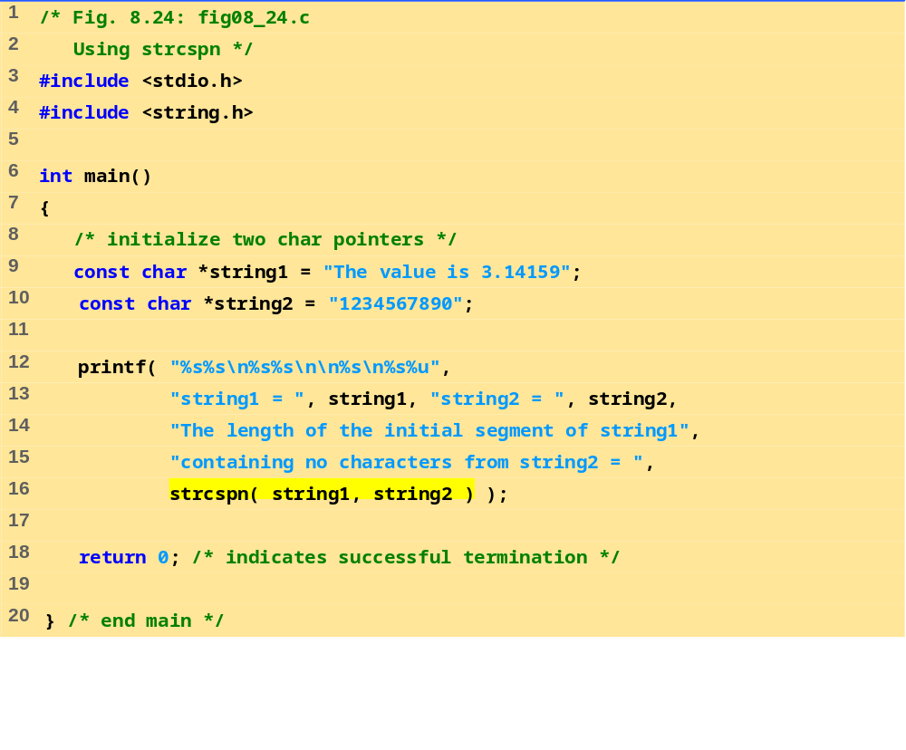
fig08_24.c
Program Output
string1 = The value is 3.14159
string2 = 1234567890
The length of the initial segment of string1
containing no characters from string2 = 13

Slide 41
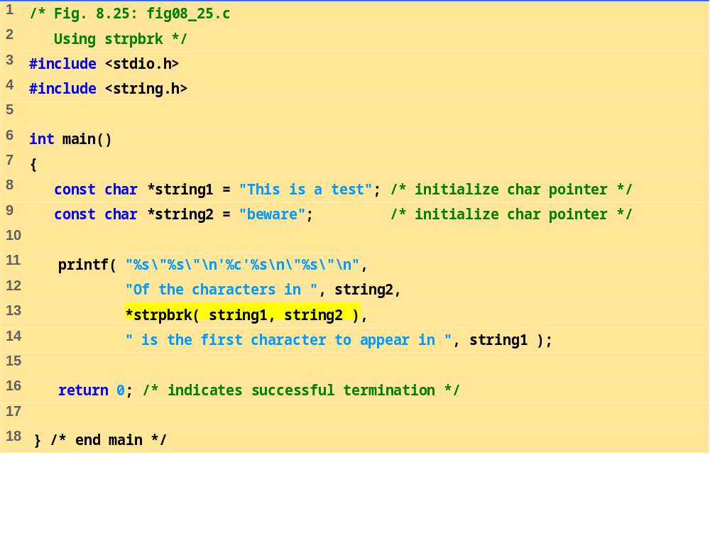
fig08_25.c
Program Output
Of the characters in "beware"
'a' is the first character to appear in
"This is a test"

Slide 42
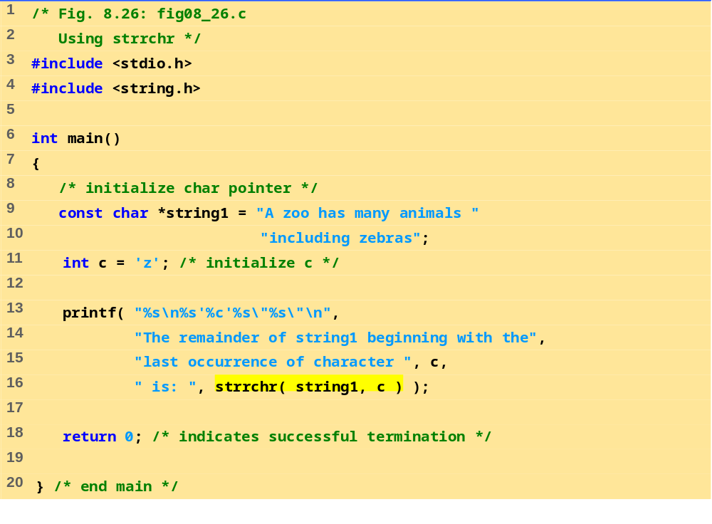
fig08_26.c
Program Output
The remainder of string1 beginning with the
last occurrence of character 'z' is: "zebras"

Slide 43
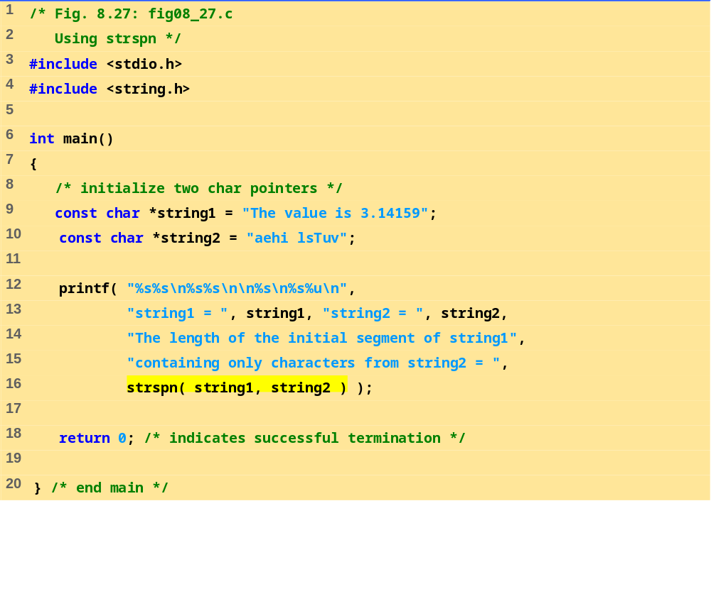
fig08_27.c
Program Output
string1 = The value is 3.14159
string2 = aehi lsTuv
The length of the initial segment of string1
containing only characters from string2 = 13

Slide 44
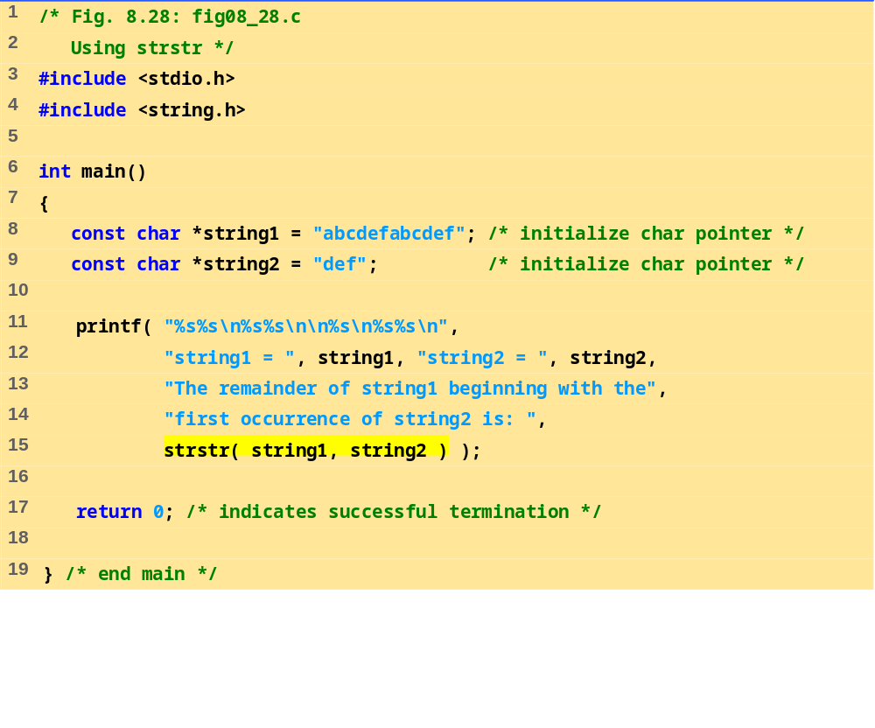
fig08_28.c
Program Output
string1 = abcdefabcdef
string2 = def
The remainder of string1 beginning with the
first occurrence of string2 is: defabcdef

Slide 45
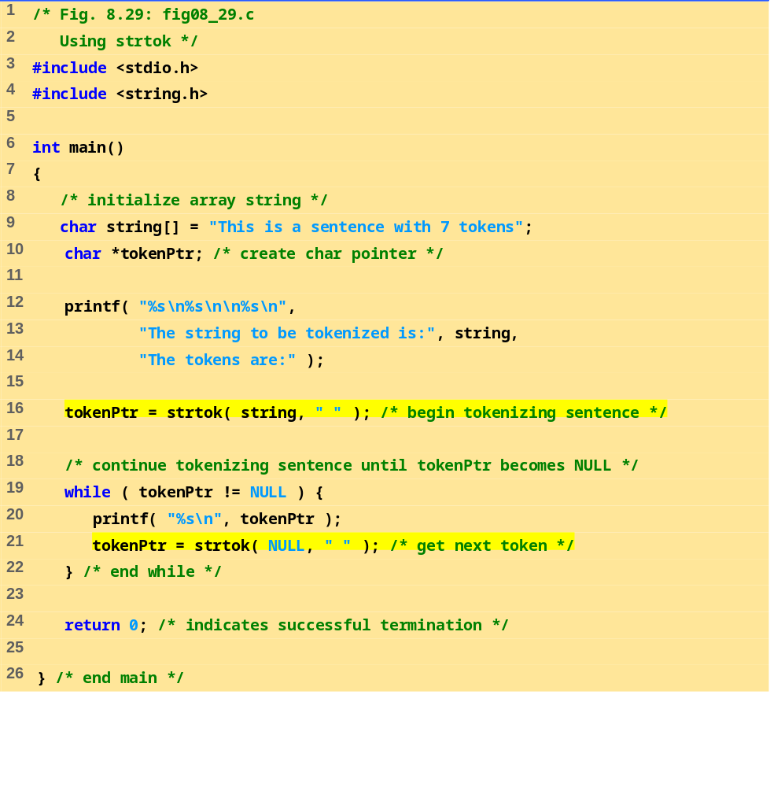
fig08_29.c

Slide 46
The string to be tokenized is:
This is a sentence with 7 tokens
The tokens are:
This
is
a
sentence
with
7
tokens
Program Output

Slide 47
8.9 Memory Functions of the String- handling Library
Memory Functions
  In <stdlib.h>
  Manipulate, compare, and search blocks of memory
  Can manipulate any block of data
Pointer parameters are void *
  Any pointer can be assigned to void *, and vice versa
  void * cannot be dereferenced
    Each function receives a size argument specifying the number of bytes (characters) to process

Slide 48
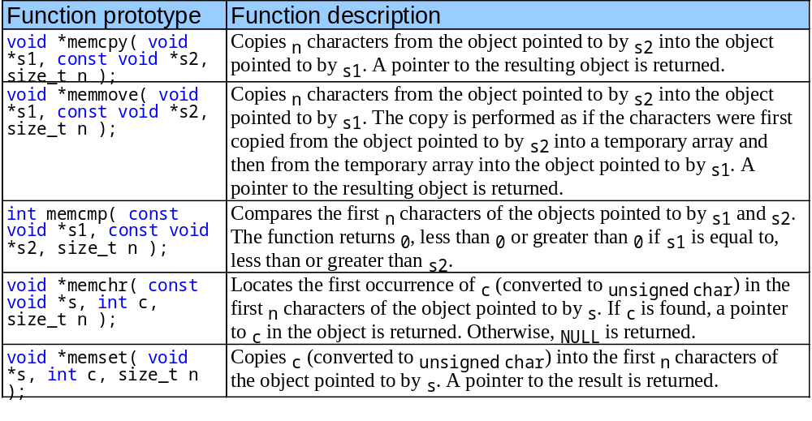
8.9 Memory Functions of the String- handling Library

Slide 49
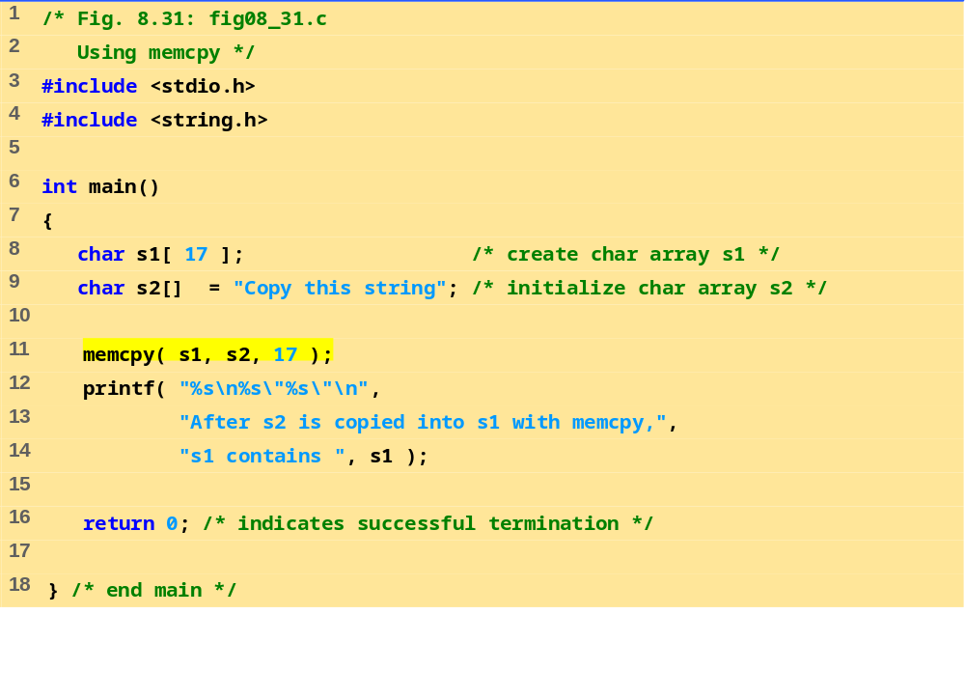
fig08_31.c
Program Output
After s2 is copied into s1 with memcpy,
s1 contains "Copy this string"

Slide 50
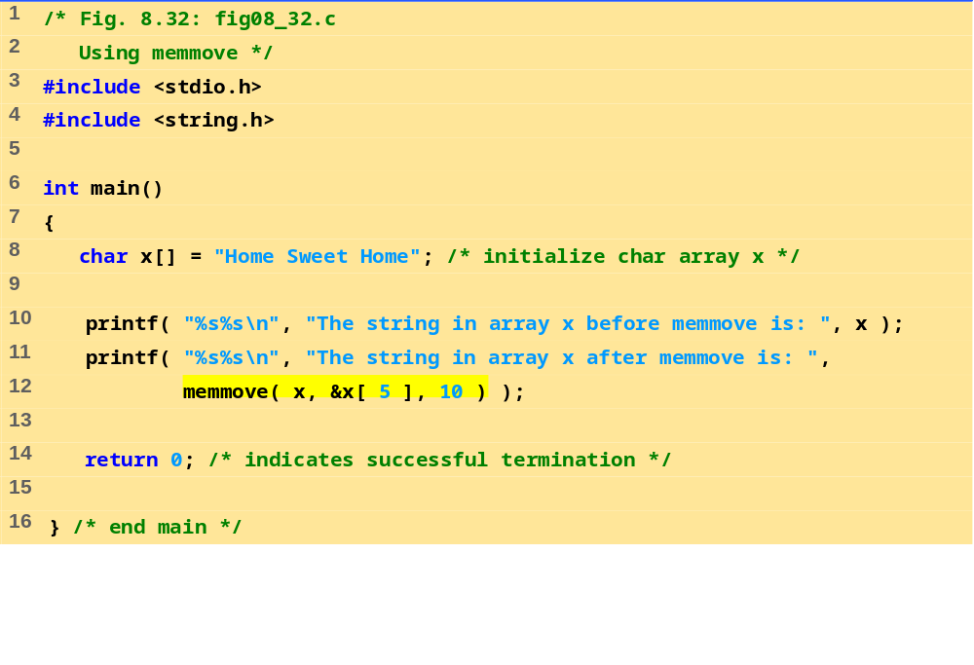
fig08_32.c
Program Output
The string in array x before memmove is: Home Sweet Home
The string in array x after memmove is: Sweet Home Home

Slide 51
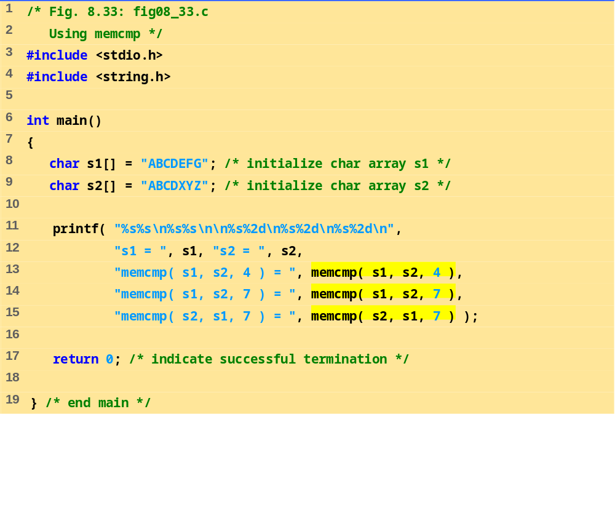
fig08_33.c
Program Output
s1 = ABCDEFG
s2 = ABCDXYZ
memcmp( s1, s2, 4 ) = 0
memcmp( s1, s2, 7 ) = -1
memcmp( s2, s1, 7 ) = 1

Slide 52
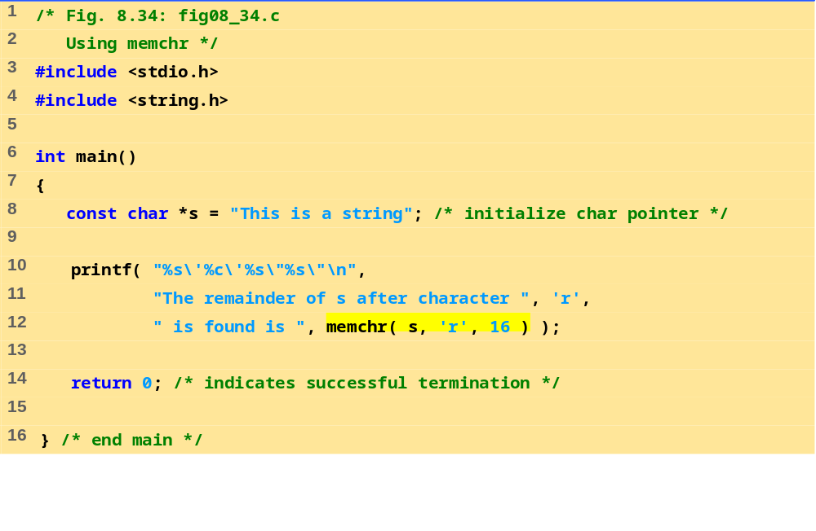
Fig8_34.c
Program Output
The remainder of s after character 'r' is found is "ring“

Slide 53
8.10 Other Functions of the String Handling Library
char *strerror( int errornum );
  Creates a system-dependent error message based on errornum
  Returns a pointer to the string
size_t strlen( const char *s );
  Returns the number of characters (before NULL) in string s

Slide 54
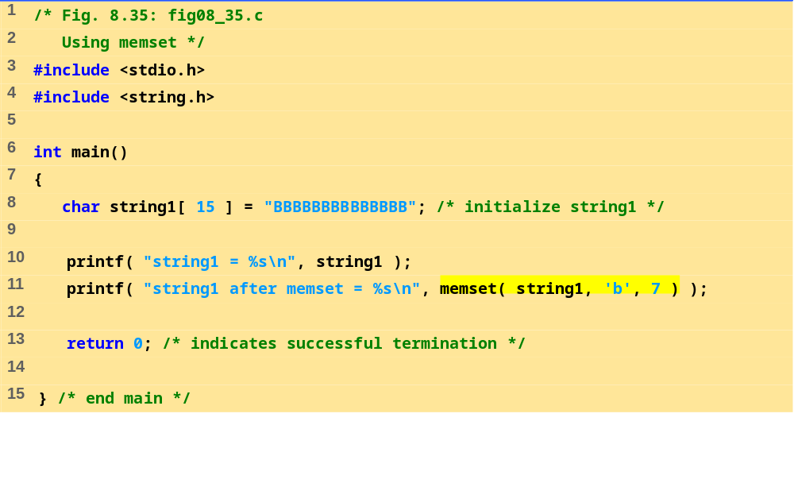
fig08_35.c
Program Output
string1 = BBBBBBBBBBBBBB
string1 after memset = bbbbbbbBBBBBBB

Slide 55
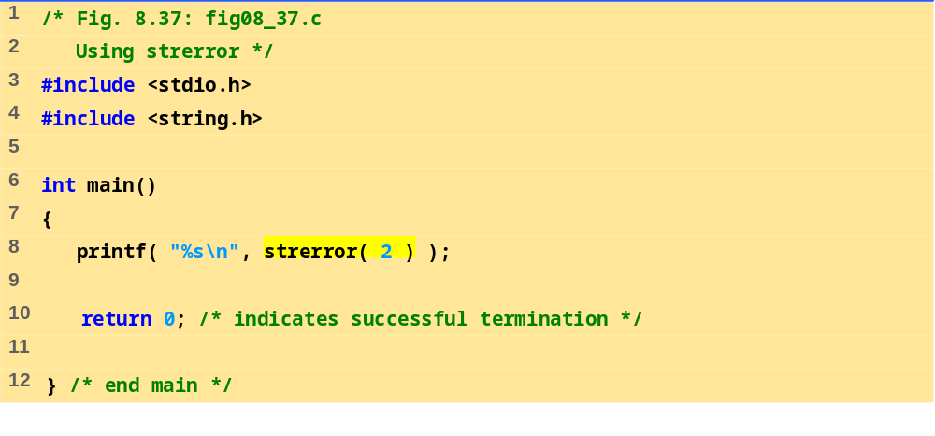
fig08_37.c
Program Output
No such file or directory

Slide 56
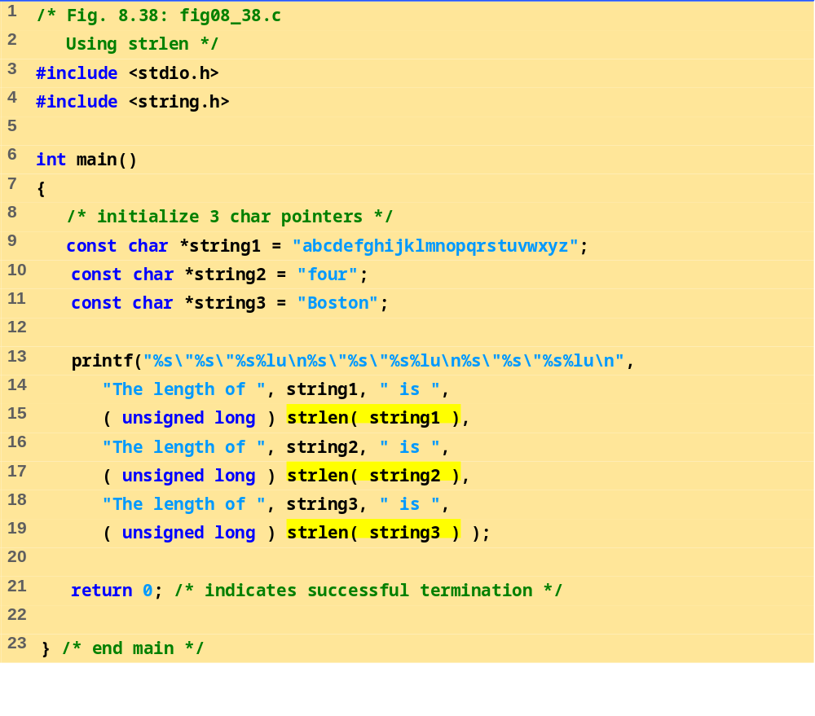
fig08_38.c
Program Output
The length of "abcdefghijklmnopqrstuvwxyz" is 26
The length of "four" is 4
The length of "Boston" is 6

